Slide 1
Comparison of Annual Members & Casual Riders Bike Usage
Presented By: Ifechi Mafiana
Date: 12/23/2022

Slide 2
Table of Contents:
Objective
Findings
Recommendations
Wrap up and conclusions

Slide 3
Objective
Objective of the analysis:
To analyze Cyclistic bike ride previous 12 months data in order to understand how annual members and casual riders use Cyclistic bikes differently which would help set a digital marketing strategy to convert casual riders into annual riders.
Summary about the company:
Cyclistic is a bike-share company that features more than 5,800 bicycles and 600 docking stations. Cyclistic sets itself apart by also offering reclining bikes, hand tricycles, and cargo bikes, making bike-share more inclusive to people with disabilities and riders who can’t use a standard two-wheeled bike. Cyclistic was founded in 2016 in Chicago.
Dataset used and data source:
Cyclistic historical trip data for previous 12 months from Dec. 2021 to Nov. 2022
Data source: https://divvy-tripdata.s3.amazonaws.com/index.html from Google Data Certification program on Coursera online learning platform.

Slide 4
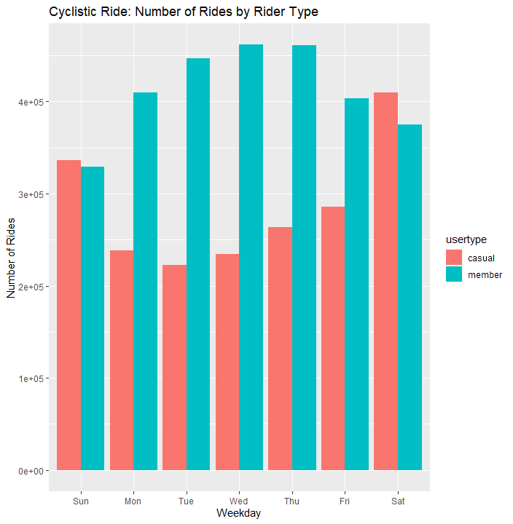
Findings:
Number of trips: Weekday
Casual riders are more active during weekends
(Saturdays & Sundays)
Annual Members rides were consistent weekdays
from Mondays to Friday

Slide 5
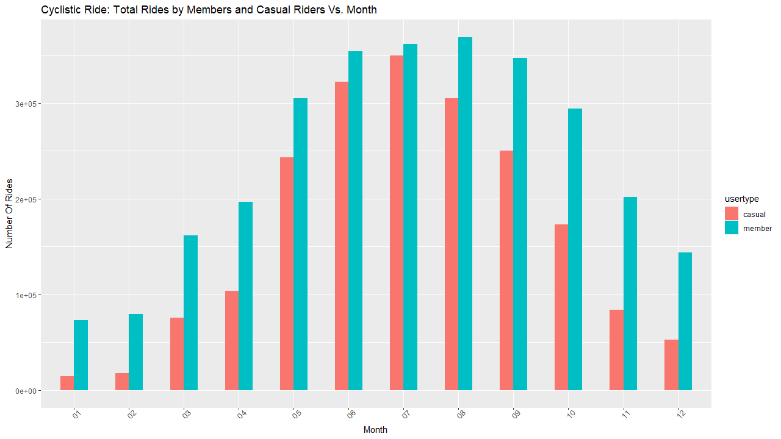
Findings:
Number of trips: Months
Annual Members had more rides all year round
The months of June, July, August, and September
Were the most busy time of the year.

Slide 6
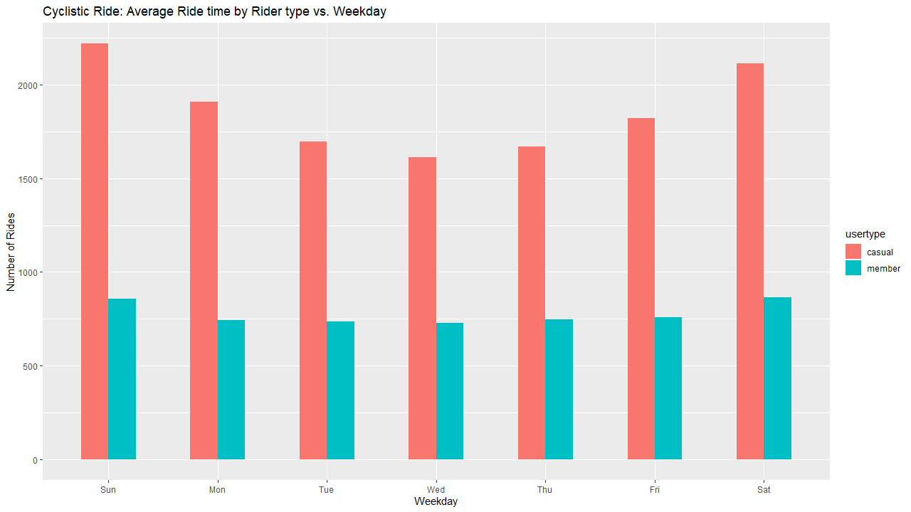
Findings:
Average Number of trips: Weekday
Casual riders on the average had more rides than
annual members
The average number of rides for annual members
Were very low compared to casual riders

Slide 7
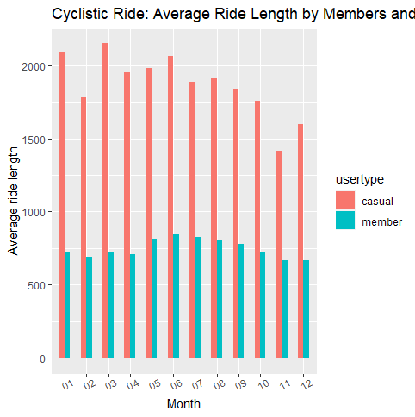
Findings:
Average Number of trips: Months
The average ride length of casual riders was between 1500
and 2000, while the average ride length of annual was less than
1000 throughout the year.
March represents the month with the highest average length
by casual riders

Slide 8
Recommendations:
Wrap-up:
The data suggests that most annual members use Cyclistic bikes for work commuting
Casual riders use Cyclistic bikes mainly on weekends which suggests its usage for leisure and sports
Both annual members and casual riders prefer the classic and docked bikes over electric bikes
2. Recommendations:
Create a digital campaign targeting active casual riders at weekends and during official working hours, different subscription plans such as weekends-only should be designed.
Along with the digital campaigns, rebates and discounts could be offered to casual riders for the usage of electric bikes. Health, environmental and financial benefits should be highlighted as some of the benefits of electric bikes over classic bikes
These campaigns can be channeled through member emails, docking stations and weekend events

Slide 9
What’s next?
Further investigations to be carried out to clarify anomalies in the existing data;
a. Trip lengths (in seconds) less than or equal to 0
b. Station names with null values
c. Non-unique ride IDs
More data should be gathered
a. Gathering more data about riders can help discover unique trends which helps design a more targeted campaigns
b. Multiple years of data gathered can be compared to global crisis such as Covid-19 to see how they affect the trends and patterns of riders

Slide 10
Thank you !!!
Questions and feedbacks will be appreciated…

